Slide 1

How I chose my house colors
Color Math library

Slide 2
A quick introduction to color spaces

Slide 3
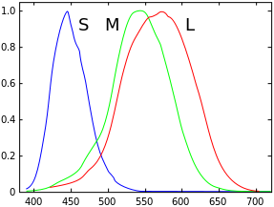
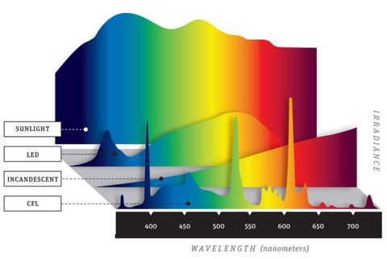
Spectral Color
Human spectral sensitivity to visible light
Notes:
The visible part of the electro magnetic spectrum is approximately the range between 380nm and 750 nm. The varying intensity across these frequencies that an object reflects or in the case of a light source, generates is what gives it a particular “color” – and total amount of energy is what we’d see as brightness. When you have an object + illumination source, those frequencies go to your eye ball, and the cones in your eyes add their own special sauce the result is color perception. Technically it’s a color space of infinite dimensions because it’s based on whatever sampling frequency you’ve decided on but practically each color is a 36 element vector (sampling every 10 nm)
If two samples have the same spectral curve, they will be perceived the same no matter the illumination. If sample A is green in LED light, sample B will also be green in LED light. If the same sample A looks blue in CFL light, sample B will also look blue in CFL light. Spectral curve is kind of “the truth” of a color.

Slide 4
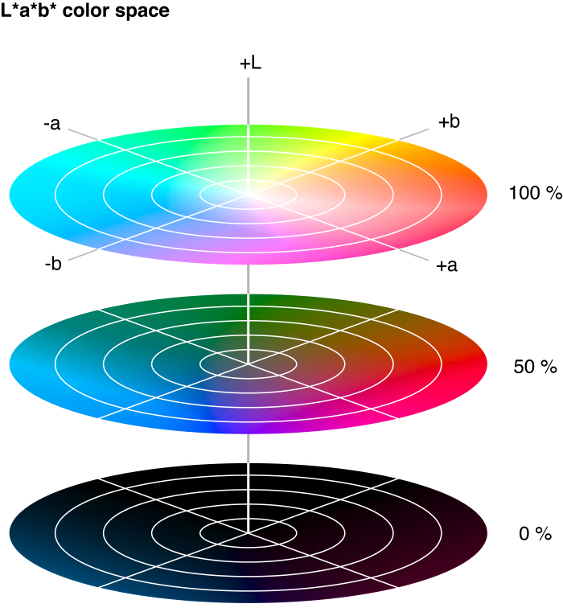
L*a*b* Color
Official name CIELAB (established/maintained by the International Commission on Illumination)
Every color is an element in a 3space
L is brightness (1 is bright, 0 is dark)
-a is green, +a is red
-b is blue, +b is yellow
Values near zero for a and b are gray
Designed to be perceptually neutral (every step in every direction of the same magnitude should be the same amount different to the human eye – turns out it’s not, but they tried and it’s still close).
This means you can use Euclidean distance between colors as a measure of perceptual distance.
The standard in many print/production color management systems.
Notes:
Note, this has a one-to-one mapping with CIEXYZ

Slide 5
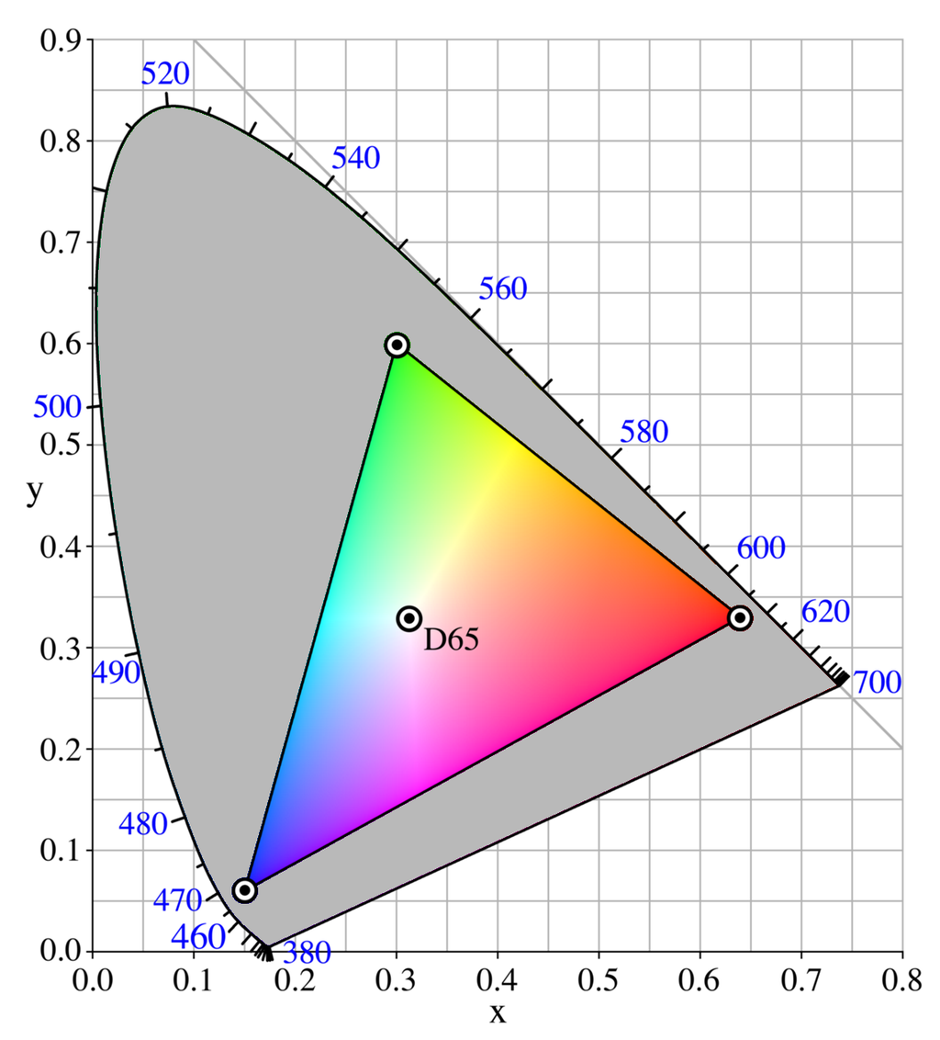
RGB Color
“additive” color space – each parameter is how much of that color to “add” to the pixel.
Often describe with “hex code” strings, with two digits for each color. Examples:
#FF0000 is red – max value of red, zero for other two
#FF00FF is magenta, max red and blue, zero green.
#888888 is a mid-gray, equal of all colors but less bright.
Does not cover the same range of colors as L*a*b* - the triangle on the figure to the left shows you the range of RGB colors and outside that triangle is the rest of the colors people can see – most “pastels” are impossible to depict with RGB.

Slide 6
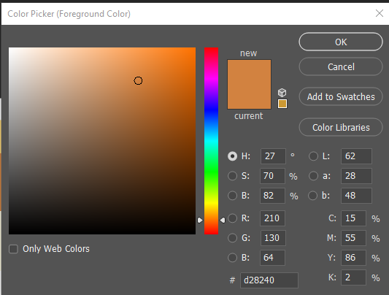
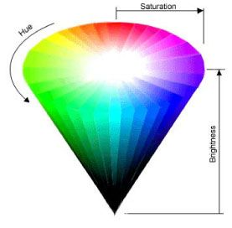
HSB Color
This is a transform of RGB (i.e. there is a one-to-one correspondence between RGB and HSB)
Parameters
Hue - an angle on a color wheel
Saturation – distance from origin
Brightness – similar to L*
Big advantage is that parmetricization is closer to how people actually think about and perceive color
“That’s too green”
“I want it brighter”
“Can we make it paler?”

Slide 7
Now to the house colors

Slide 8
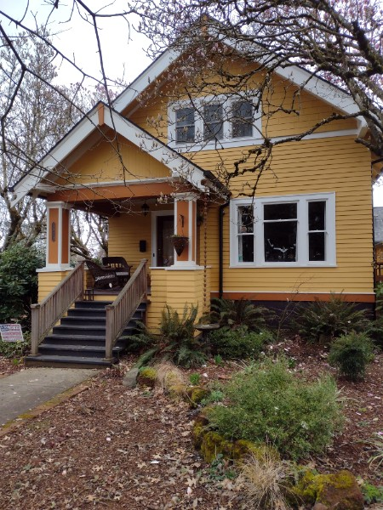
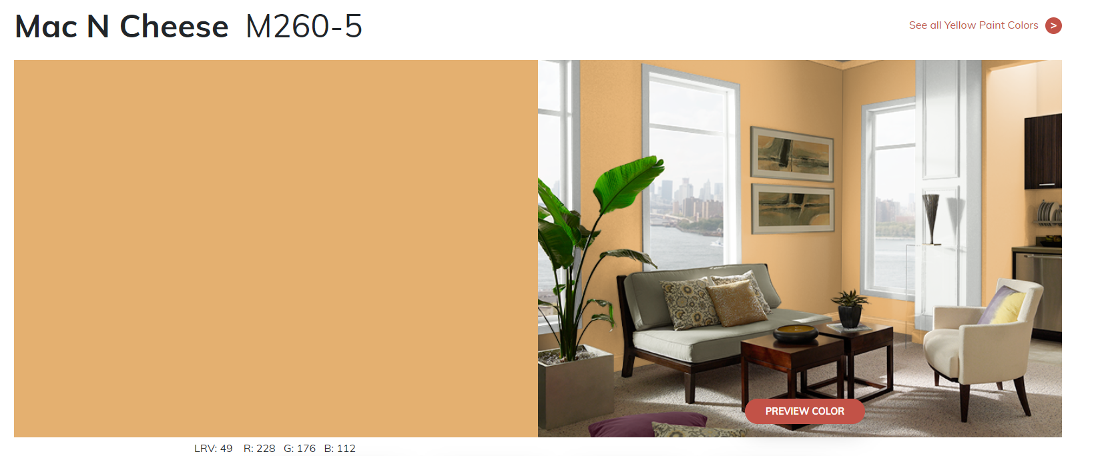
The model house
All paint website now include the RGB value of their paint. Obviously I’d prefer L*a*b* but we do what we can!
Mac n Cheese
R:228
B:176
G:112
We asked the owners what color they had painted their house. The answer? Behr paint Mac N Cheese.
But we needed a color from Rodda!
LUCKILY RODDA PUBLISHES ITS ENTIRE COLOR CATALOG AS A .CSV

Slide 9
